Slide 1
DMML2 PROJECT
Topic Modelling for Inter7s Marketing Development
Bolormaa Mendbayar – x23176725
Thapelo Khantsi – x23131535
Temitope Oladimeji – x23187204
Ziyi Yan – x22198512
05/05/2024

Slide 2
Overview
- Topic Modelling used to identify potential business partnerships.
Companies aiming to improve marketing strategies.
Rise of AI presents new opportunities for companies to tailor their strategies effectively
Analytical tools can provide insights for these needs.
​

Slide 3



METHODOLOGY
Business Understanding
Data Understanding & Preparation
Modelling
Understanding what the company needs, and refining a problem statement for setting goals and objectives
Assessing the state of data for the company for the defined problem statement
Data Creation: Manual Web Scrapping
Data Preprocessing
NLP Text Manipulation
Topic Modelling: Is a statistical modelling techniques that uses unsupervised ML to analyse documents and identify common themes/topics
LDA: Uncovers the hidden structure by looking at the relationships between words in a document and grouping them into topics

Slide 4
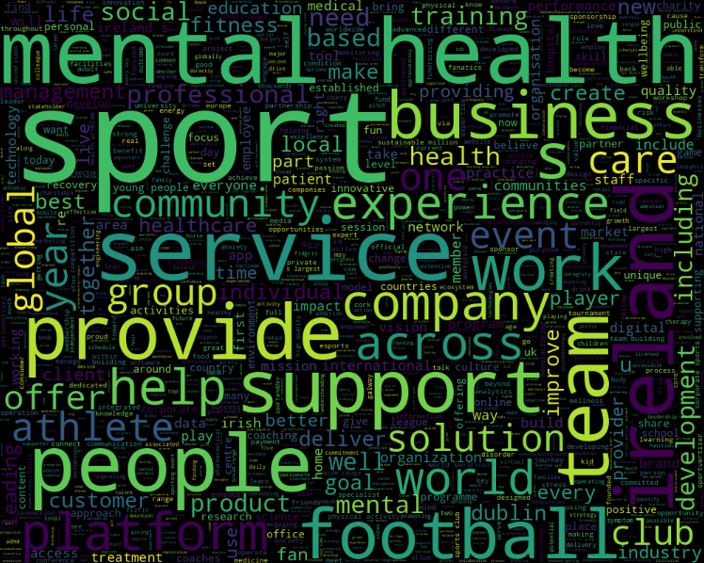
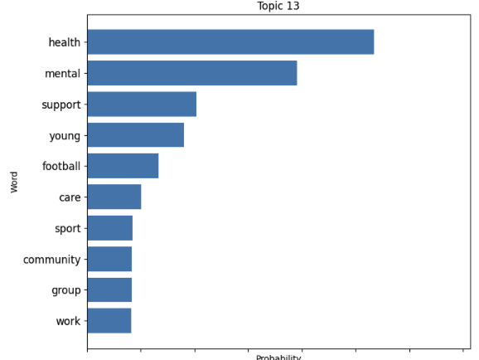
Data Analysis
EDA
To verify data pre-processing​
Stop Words
Visual
The topic where the optimal company ID recites.

Slide 5
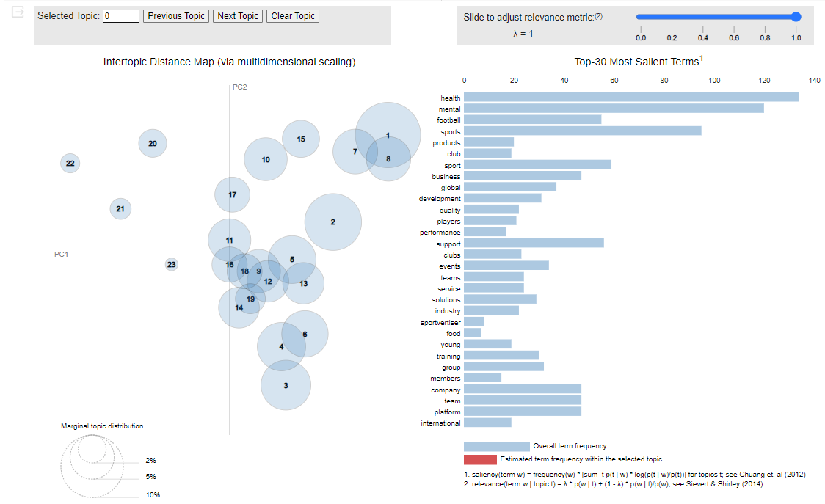
Evaluation
Identified 23 as optimal number of topic through iterative process
Company ID 22 and Topic 13, with total relevance score of 0.997
Optimal company website
Athletes for Hope | The Intersection of Sports and Philanthropy

Slide 6
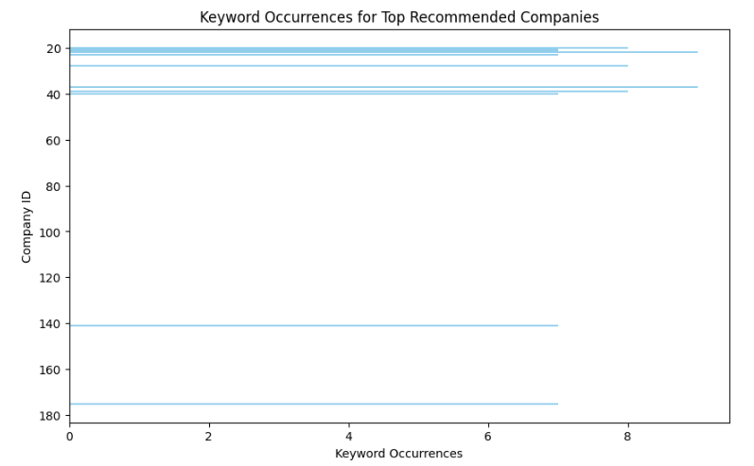
Evaluation
Top recommended companies probabilities exceeding 0.9
Company ID 37, Topic 19 highlighting 9 keyword
Similarly Company ID 20,28 and 39 linked to Topic 11, 13 and 5 with 8 keyword
As well as Company ID 23, 141 and 175 respectively to Topic 17, 6 and 13 with 7 keyword occurrences.

Slide 7
Conclusion
The reliability of the analysis validates the use of LDA in this way.
The novel application of topic modelling offers a chance to explore non-related topics.
FUTURE WORK
More Data
Utilization of Interval Semi-supervised LDA (ISLDA ): It is suitable for predefined set of keywords that are mapped to a specific interval of topic assignments.
Assess topic relevance via topic alignment

